Slide 1
MCA-II (Semester- III) Subject :- Software Testing & Quality Assurance (Subject Code:- IT-33) Chapter: 2] Software Testing Fundamentals
Prof. Sachin Lende

Slide 2
Testing is the process of operating a system or component under specified conditions, observing or recording results and making an evaluation of some aspect of the system or component

Slide 3
Verification:
Verification is the process of evaluating a system or component to determine whether the products of a given development phase satisfy the conditions imposed at the start of the phase.
Validation:
Validation is the process of evaluating a system or component during or at the end of the development process to determine whether it satisfies the specified requirements.
Testing = verification + Validation

Slide 4
Testing Objectives:
S/w testing remove bugs from s/w modules / statements/ function / branch / looping etc.
S/w testing removes errors in the system at interfaces.
S/w testing provides a system as per the requirement specification.
S/w testing meets the design specifications.
S/w testing ensures the correct data flow.
S/w testing ensures that the process & desired product standards are followed.
S/w testing gives the quality product.
S/w testing is required to review the requirement specifications, design & coding.

Slide 5
What is a BUG?
Bug is the fault i.e. an error in software which if executed may cause failure. A manifestation of error in software.
A fault in program which causes the program to perform in an unintended or unanticipated manner which is found in development environment.
Failure is nothing but deviation of the software from its expected delivery or service.
An Error is nothing but a human action that produces an incorrect result.
A mismatch between the program and its specification is an error in the program if and only if the specification exists and is correct. It is deviation from actual and expected values.
An error found in product after shifting it to customer side. An incorrect step process of data definition in computer program within the context of s/w process is a Defect or fault in product.

Slide 6
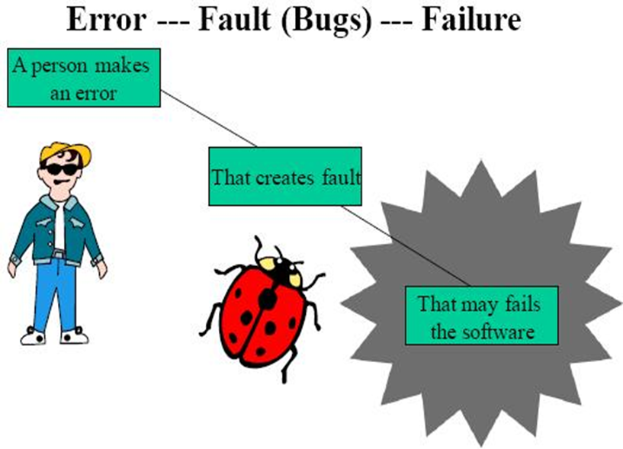

Slide 7
2.4 Economics of Testing
Testing is about getting real feedback quickly, reducing wasteful testing activities, and putting a mirror in front of our applications. It becomes advantageous to understand the costs of these activities and direct the effort investment where it's most beneficial

Slide 8
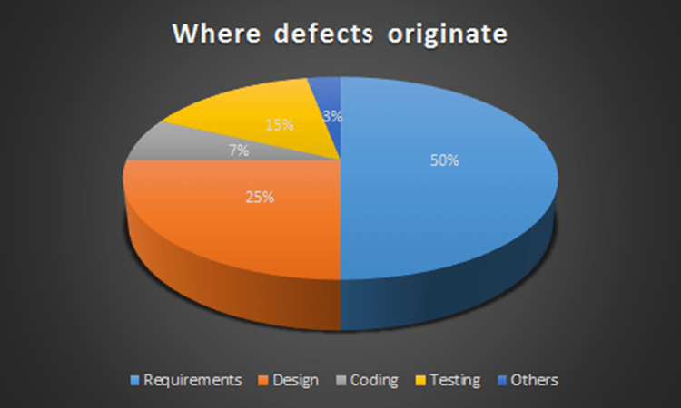

Slide 9
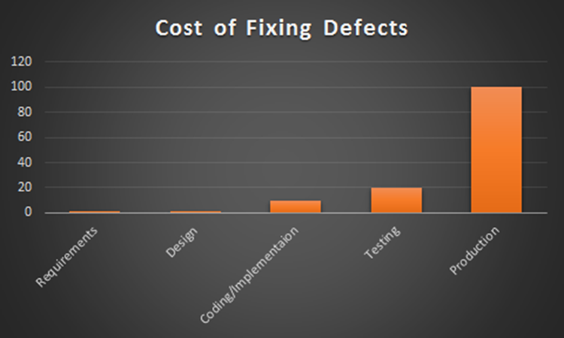

Slide 10
2.5 Seven Testing Principle
Testing shows presence of defects
Exhaustive testing is not possible
Early testing
Defect clustering
Pesticide paradox
Testing is context dependent
Absence of errors fallacy

Slide 11
Testing shows the presence of defects
The goal of software testing is to make the software fail. Software testing reduces the presence of defects. Software testing talks about the presence of defects and doesn’t talk about the absence of defects. Software testing can ensure that defects are present but it can not prove that software is defect-free

Slide 12
Exhaustive testing is not possible
It is the process of testing the functionality of the software in all possible inputs (valid or invalid) and pre-conditions is known as exhaustive testing. Exhaustive testing is impossible means the software can never test at every test case. It can test only some test cases and assume that the software is correct and it will produce the correct output in every test case. If the software will test every test case then it will take more cost, effort, etc.

Slide 13
Early Testing
Testing should start as early as possible in the Software Development Life Cycle. So that any defects in the requirements or design phase are captured in early stages. It is much cheaper to fix a Defect in the early stages of testing. To find the defect in the software, early test activity shall be started. The defect detected in the early phases of SDLC will be very less expensive. For better performance of software, software testing will start at the initial phase

Slide 14
Defect Clustering
Defect Clustering which states that a small number of modules contain most of the defects detected. This is the application of the Pareto Principle to software testing: approximately 80% of the problems are found in 20% of the modules
If the same tests are repeated over and over again, eventually the same test cases will no longer find new bugs.

Slide 15
Pesticide Paradox
Repeating the same test cases, again and again, will not find new bugs. So it is necessary to review the test cases and add or update test cases to find new bugs.
Repetitive use of the same pesticide mix to eradicate insects during farming will over time lead to the insects developing resistance to the pesticide Thereby ineffective of pesticides on insects. The same applies to software testing. If the same set of repetitive tests are conducted, the method will be useless for discovering new defects.

Slide 16
Testing is context-dependent
The testing approach depends on the context of the software developed. Different types of software need to perform different types of testing. For example, The testing of the e-commerce site is different from the testing of the Android application.

Slide 17
Absence of errors fallacy
If a built software is 99% bug-free but it does not follow the user requirement then it is unusable. It is not only necessary that software is 99% bug-free but it is also mandatory to fulfill all the customer requirements.
It is possible that software which is 99% bug-free is still unusable. This can be the case if the system is tested thoroughly for the wrong requirement. Software testing is not mere finding defects, but also to check that software addresses the business needs. The absence of Error is a Fallacy i.e. Finding and fixing defects does not help if the system build is unusable and does not fulfill the user’s needs & requirements.

Slide 18
2.6 Software Testing Life Cycle (STLC)
Software Testing Life Cycle process is an integral part of the Software Development Life Cycle. The overall aspect of STLC phase deals with testing and rectifying any error code generating within the program under various test conditions.
What is STLC?
STLC is simply a testing phase in the SDLC development. Validation and Authentication is tried and tested in this phase. The only limitation of this cycle is that it is limited to respective individual phase and is carried out by a group of skilled testers and technology evangelistic

Slide 19
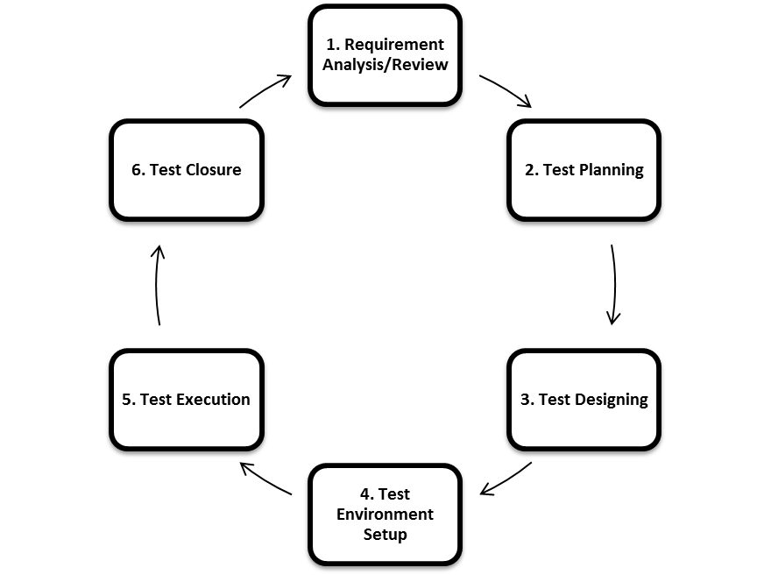

Slide 20
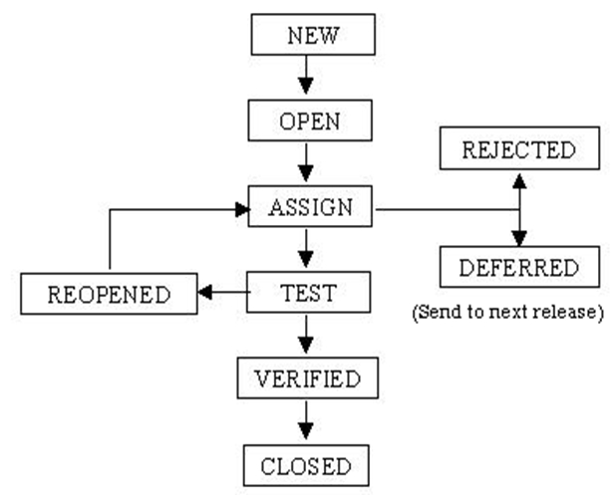
Bug Life Cycle

Slide 21
2.7 Verification & Validation Concepts
Verification
Does the product meet system specifications?
Have you built the product right?
Verification is the process of evaluating a system under development to determine that whether the system satisfy the conditions which were imposed at starting phase of system development

Slide 22
Validation
Does the product meet user expectations?
Have you built the right product?
Validation is the process of determining the correctness of the system w.r.t. user’s requirements.

Slide 23
Verification and validation are the processes in which we check a product against its specifications and the expectations of the users who will be using it

Slide 24
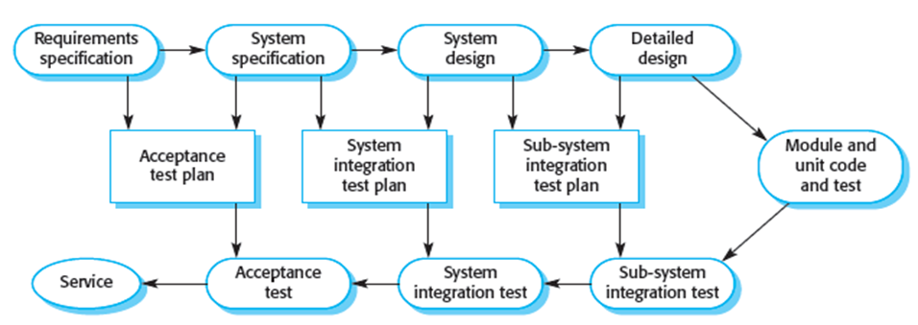

Slide 25
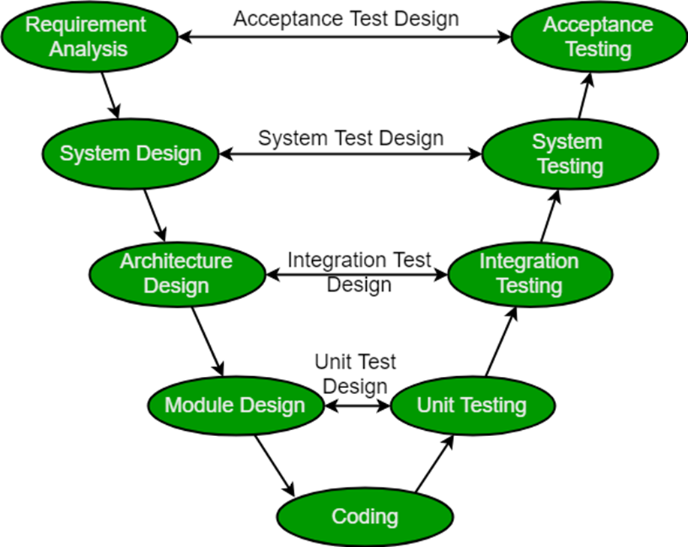
V- Model

Slide 26
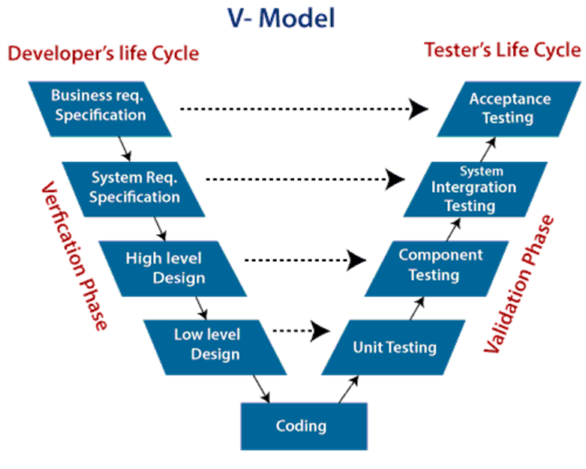

Slide 27
The left side of the model is Software Development Life Cycle – SDLC
The right side of the model is Software Test Life Cycle – STLC
The entire figure looks like a V, hence the name V – model

Slide 28
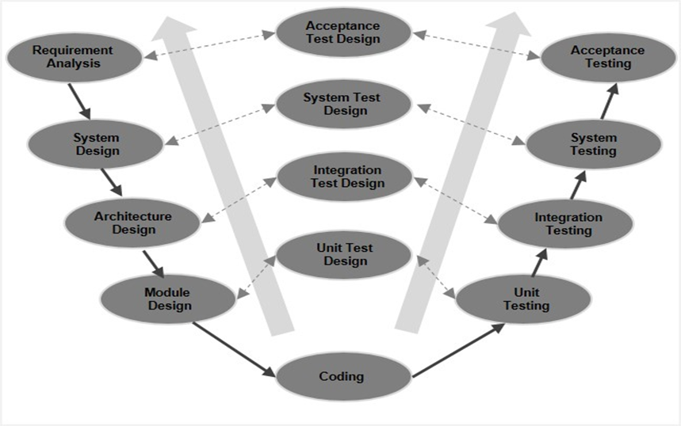
W- Model

Slide 29
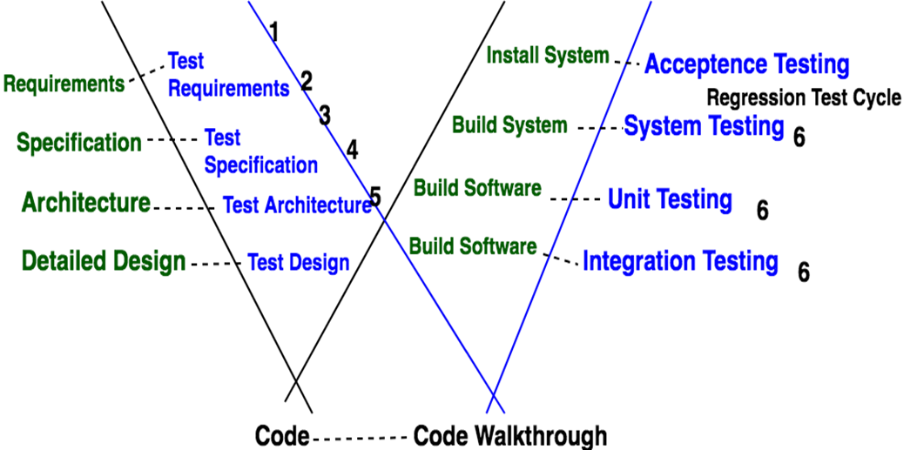

Slide 30
In W-Model there is no strict division between constructive tasks on the left-hand side and the more destructive tasks on the right-hand side.
During the test phase, the developer is responsible for the removal of defects and the correction of the implementation.
Emphasis the fact that testing is more than just construction, execution and evaluation of test cases.

Slide 31
Test Driven Development (TDD)
It is software development approach in which test cases are developed to specify and validate what the code will do. In simple terms, test cases for each functionality are created and tested first and if the test fails then the new code is written in order to pass the test and making code simple and bug-free.

Slide 32
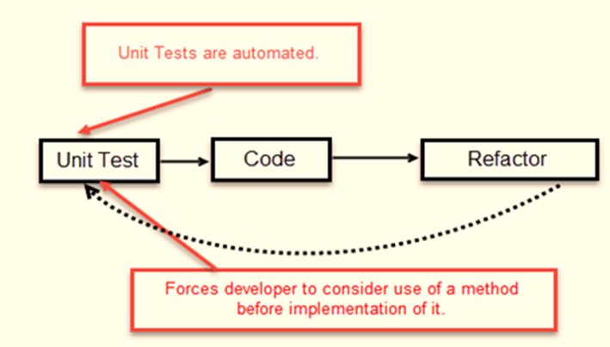

Slide 33
How to perform TDD Test
Following steps define how to perform TDD test,
Add a test.
Run all tests and see if any new test fails.
Write some code.
Run tests and Refactor code.
Repeat.

Slide 34
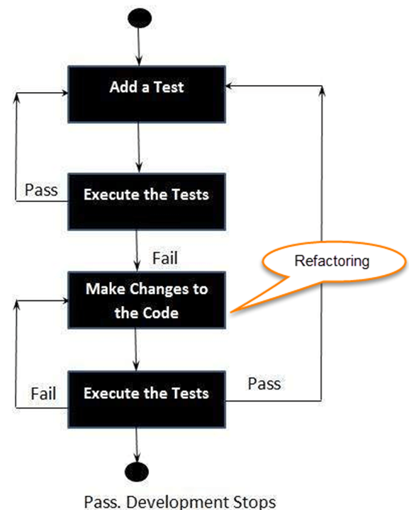

Slide 35
2.9.1 Unit Testing
It is a type of software testing where individual units or components of software are tested. The purpose is to validate that each unit of the software code performs as expected. Unit Testing is done during the development (coding phase) of an application by the developers. Unit Tests isolate a section of code and verify its correctness. A unit may be an individual function, method, procedure, module, or object.

Slide 36
Statement Coverage
Decision Coverage
Branch Coverage
Condition Coverage
Finite State Machine Coverage

Slide 37
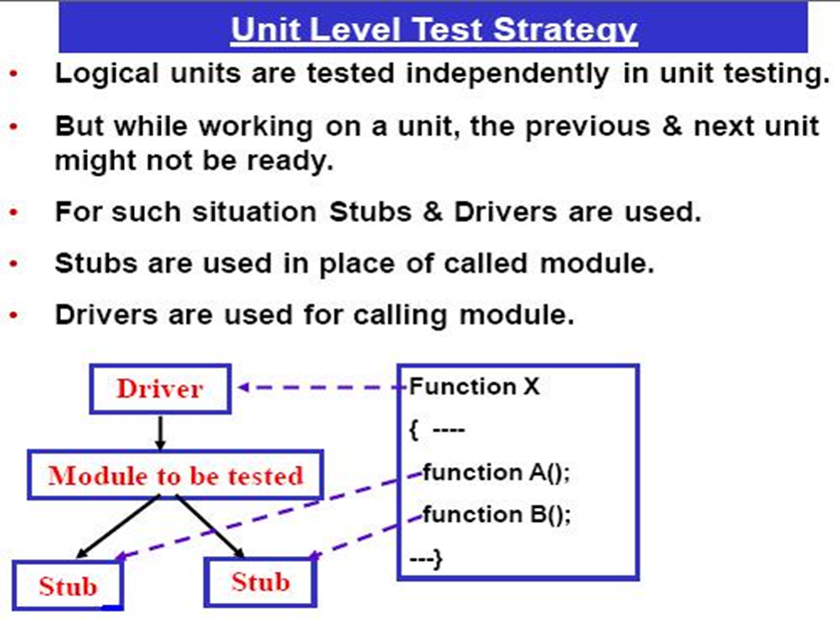

Slide 38
Stubs and Drivers are the dummy programs in Integration testing used to facilitate the software testing activity. These programs act as a substitutes for the missing models in the testing. They do not implement the entire programming logic of the software module but they simulate data communication with the calling module while testing.
Stub: Is called by the Module under Test.
Driver: Calls the Module to be tested.

Slide 39
2.9.2 Integration Testing
INTEGRATION TESTING is defined as a type of testing where software modules are integrated logically and tested as a group. A typical software project consists of multiple software modules, coded by different programmers. The purpose of this level of testing is to expose defects in the interaction between these software modules when they are integrated

Slide 40
Big Bang Testing is an Integration testing approach in which all the components or modules are integrated together at once and then tested as a unit. This combined set of components is considered as an entity while testing. If all of the components in the unit are not completed, the integration process will not execute.

Slide 41
In the Incremental Testing approach, testing is done by integrating two or more modules that are logically related to each other and then tested for proper functioning of the application. Then the other related modules are integrated incrementally and the process continues until all the logically related modules are integrated and tested successfully

Slide 42
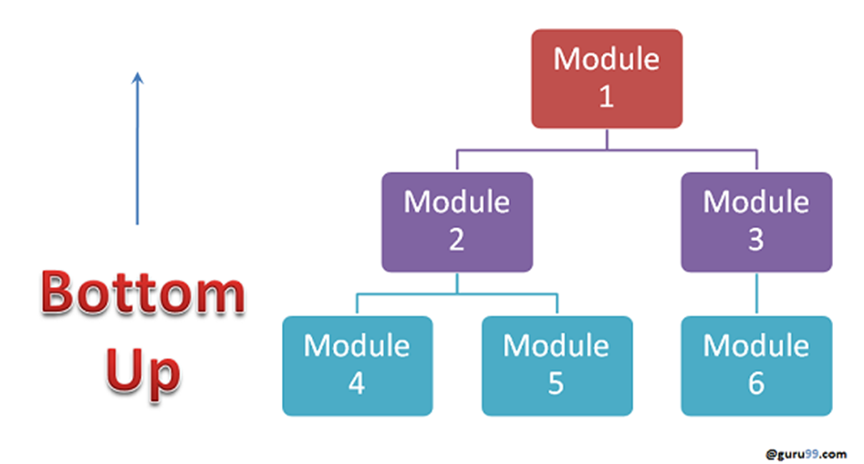

Slide 43
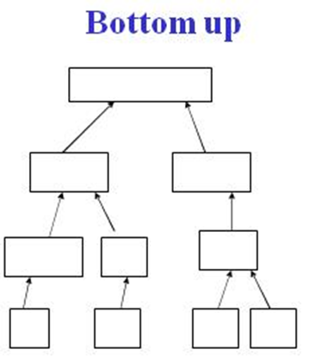

Slide 44
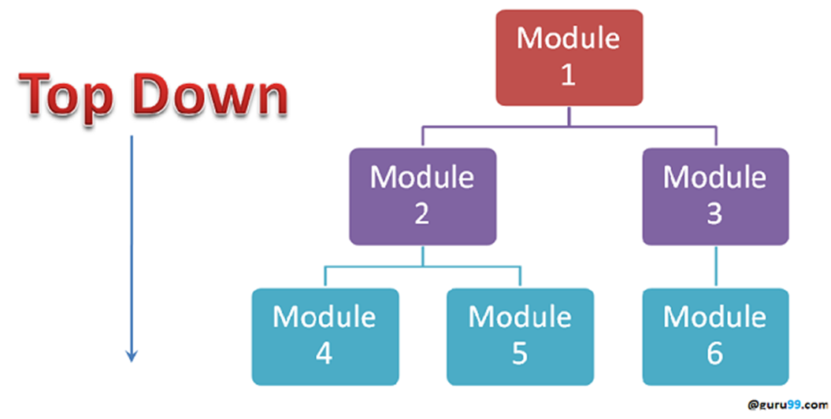

Slide 45
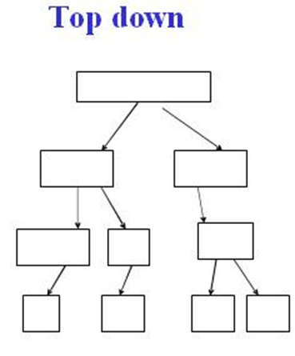

Slide 46
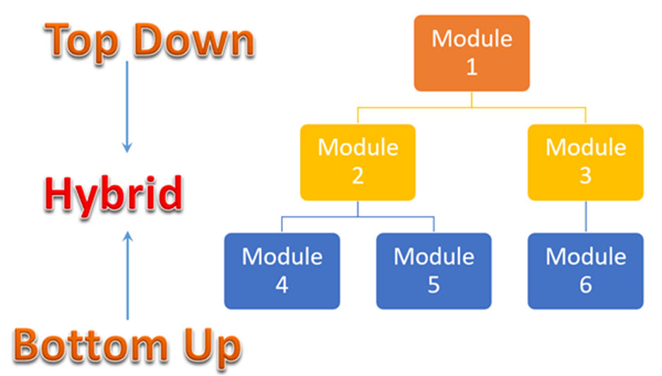

Slide 47
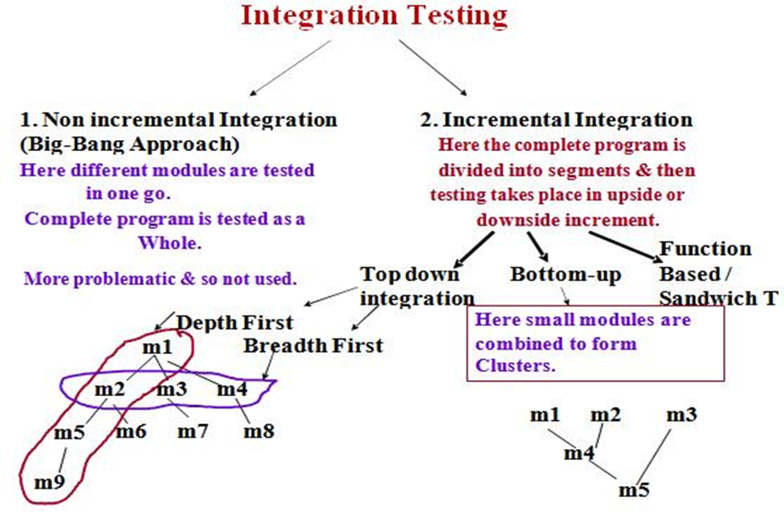

Slide 48
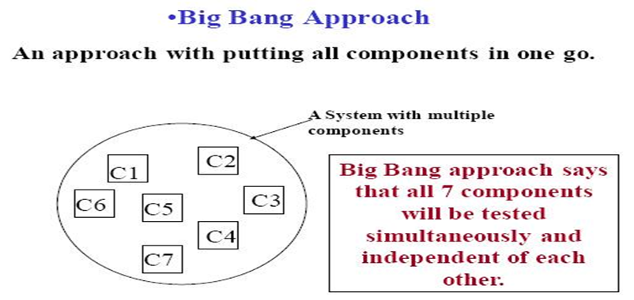

Slide 49
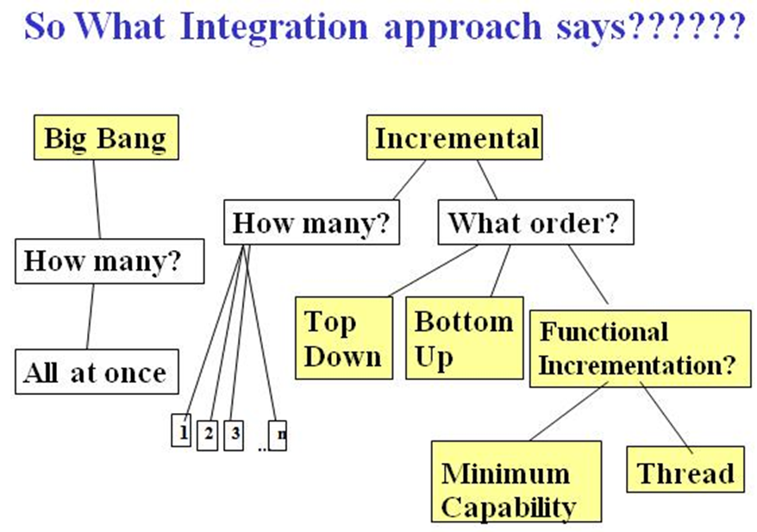

Slide 50
2.9.3 System Testing
System Testing is a level of testing that validates the complete and fully integrated software product. The purpose of a system test is to evaluate the end-to-end system specifications. Usually, the software is only one element of a larger computer-based system. Ultimately, the software is interfaced with other software/hardware systems. System Testing is actually a series of different tests whose sole purpose is to exercise the full computer-based system.

Slide 51
System Testing is a testing technique performed to evaluate the complete system the system's compliance against specified requirements. In System testing, the functionalities of the system are tested from an end-to-end perspective.
System Testing is usually carried out by a team that is independent of the development team in order to measure the quality of the system unbiased. It includes both functional and Non-Functional testing.

Slide 52
2.9.4 User Acceptance Testing (UAT)
User Acceptance Testing (UAT) is a type of testing performed by the end user or the client to verify/accept the software system before moving the software application to the production environment. UAT is done in the final phase of testing after functional, integration and system testing is done.
Acceptance testing is formal testing based on user requirements and function processing. It determines whether the software is conforming specified requirements and user requirements or not. It is conducted as a kind of Black Box testing where the number of required users involved testing the acceptance level of the system. It is the fourth and last level of software testing.

Slide 53
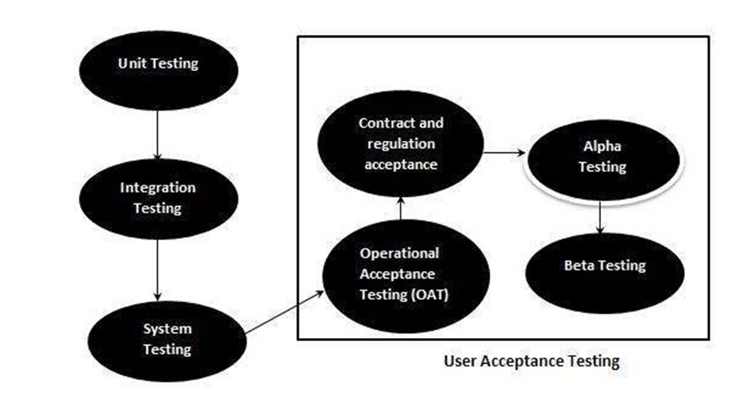

Slide 54
Acceptance criteria are defined on the basis of the following attributes
Functional Correctness and Completeness
Data Integrity
Data Conversion
Usability
Performance
Timeliness
Confidentiality and Availability
Install ability and Upgradability
Scalability
Documentation

Slide 55
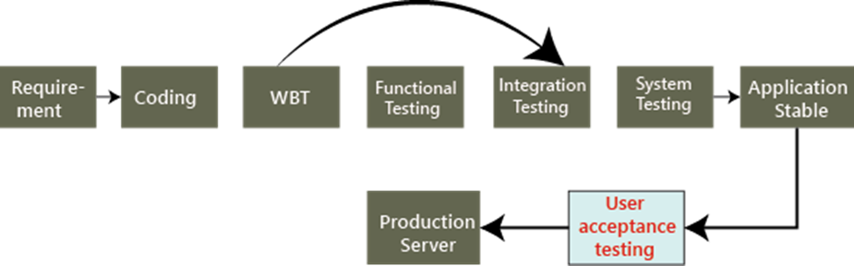

Slide 56
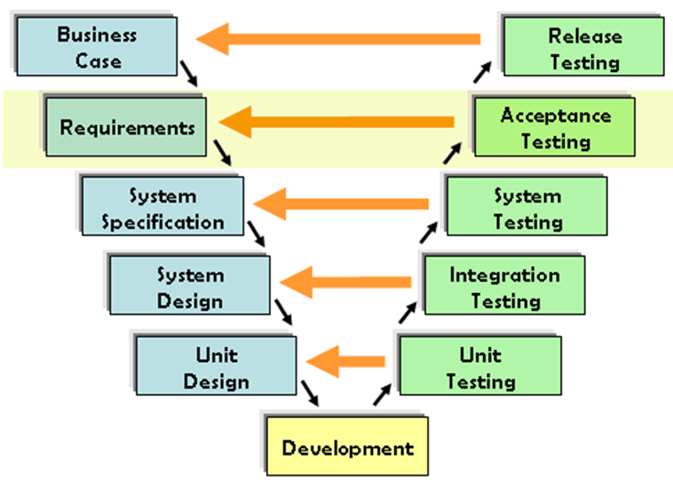
Acceptance Testing and V-Model

Slide 57
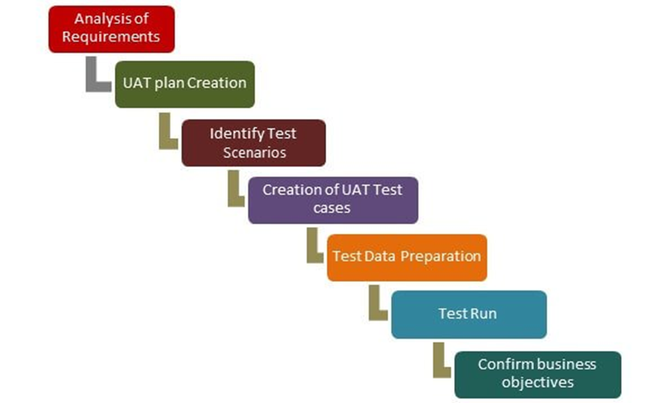

Slide 58
2.10.1 Functional Testing (Black Box)
Black Box Testing is a software testing method in which the functionalities of software applications are tested without having knowledge of internal code structure, implementation details and internal paths. Black Box Testing mainly focuses on input and output of software applications and it is entirely based on software requirements and specifications. It is also known as Behavioral Testing.

Slide 59
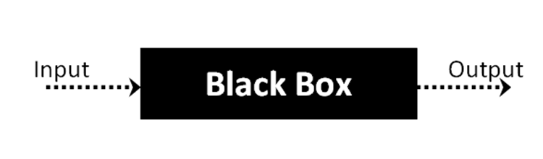

Slide 60
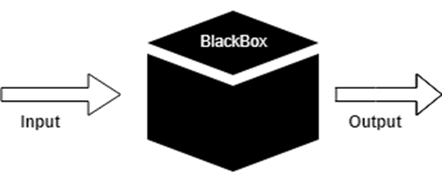

Slide 61
2.10.2 Non-functional testing (Testing of software product characteristics)
In non-functional testing the quality characteristics of the component or system is tested. Non-functional refers to aspects of the software that may not be related to a specific function or user action such as scalability or security

Slide 62
2.10.3 Structural testing (White-Box Testing )
White Box Testing is software testing technique in which internal structure, design and coding of software are tested to verify flow of input-output and to improve design, usability and security. In white box testing, code is visible to testers so it is also called Clear box testing, Open box testing, Transparent box testing, Code-based testing and Glass box testing.

Slide 63
White box testing involves:-
Internal security holes
Broken or poorly structured paths in the coding processes
The flow of specific inputs through the code
Expected output
The functionality of conditional loops
Testing of each statement, object, and function on an individual basis

Slide 64
2.10.4 Testing related to changes – Confirmation (Re-testing) and Regression Testing
Retesting is a process to check specific test cases that are found with bug/s in the final execution. Generally, testers find these bugs while testing the software application and assign it to the developers to fix it. Then the developers fix the bug/s and assign it back to the testers for verification. This continuous process is called Retesting.

Slide 65
What is Regression Testing?
Regression Testing is a type of software testing executed to check whether a code change has not unfavorably disturbed current features & functions of an Application

Slide 66
Regression testing is a type of software testing that seeks to uncover new software bugs, or regressions, in existing functional and non-functional areas of a system after changes such as enhancements, patches or configuration changes, have been made to them.
The intent of regression testing is to ensure that changes such as those mentioned above have not introduced new faults.
One of the main reasons for regression testing is to determine whether a change in one part of the software affects other parts of the software.
Regression testing include rerunning previously completed tests and checking whether program behavior has changed and whether previously fixed faults have re-emerged.
Regression testing can be performed to test a system efficiently by systematically selecting the appropriate minimum set of tests needed to adequately cover a particular change

Slide 67
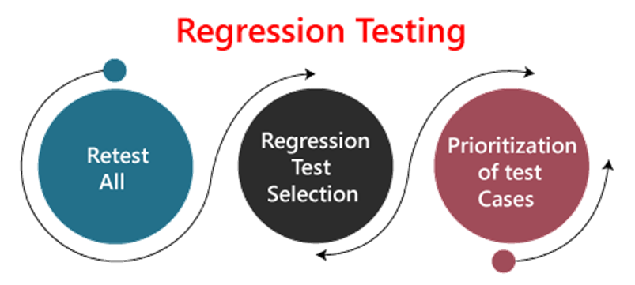

Slide 68
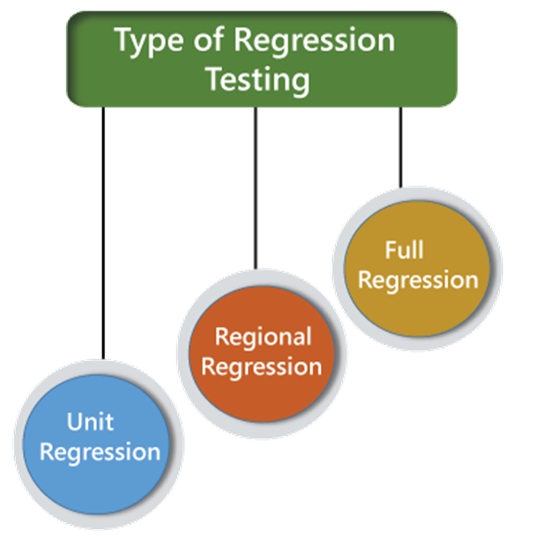

Slide 69
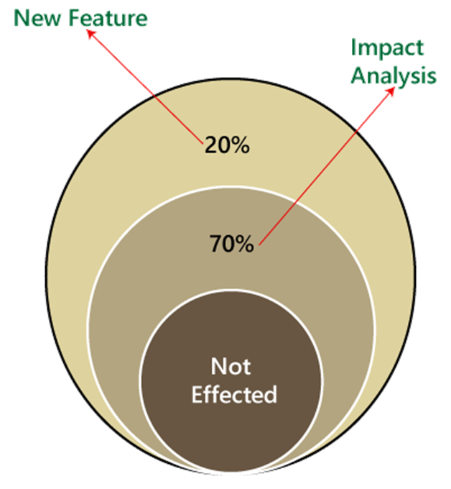

Slide 70
Re-testing | Regression Testing
Re-testing is performed to ensure that the test cases that are failed in the final execution are passing after the defects fixed. | Regression Testing is done to confirm whether the code change has not affected the existing features.
Re-Testing works on defect fixes. | The purpose of regression testing is to ensure that the code changes adversely not affect the existing functionality.
Defect verification is the part of the Retesting. | Regression testing does not include defect verification
The priority of Retesting is higher than Regression Testing, so it is done before the Regression Testing. | Based on the project type and availability of resources, regression testing can be parallel to Retesting.
Re-Test is a planned Testing. | Regression testing is a generic Testing.
We cannot automate the test-cases for Retesting. | We can do automation for regression testing; manual testing could be expensive and time-consuming.
Re-testing is for failed test-cases. | Regression testing is for passed Test-cases.
Re-testing make sure that the original fault is corrected. | Regression testing checks for unexpected side effect.
Retesting executes defects with the same data and the same environment with different input with a new build. | Regression testing is when there is a modification or changes become mandatory in an existing project.
Re-testing cannot do before start testing. | Regression testing can obtain test cases from the functional specification, user tutorials and manuals, and defects reports in regards to the corrected problem.

Slide 71
2.11.1 Performance (Load & Stress) Testing
Performance Testing is a software testing process used for testing the speed, response time, stability, reliability, scalability and resource usage of a software application under particular workload. The main purpose of performance testing is to identify and eliminate the performance bottlenecks in the software application

Slide 72
“Checking the behavior of an application by applying some load is known as performance testing.”
Speed – Determines whether the application responds quickly
Scalability – Determines maximum user load the software application can handle.
Stability – Determines if the application is stable under varying loads

Slide 73
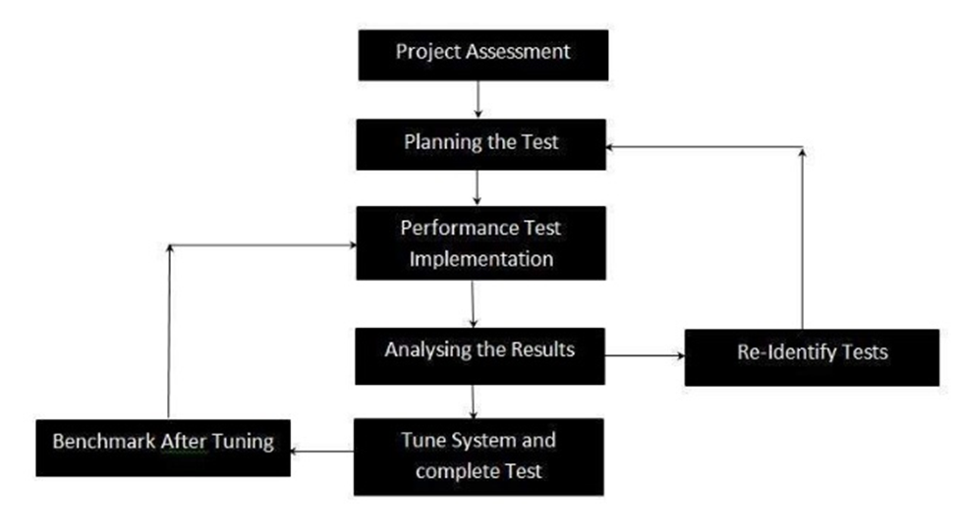

Slide 74
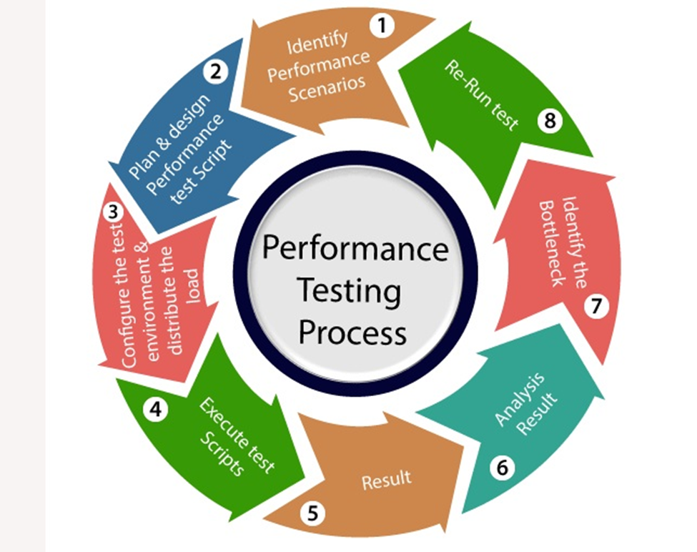

Slide 75
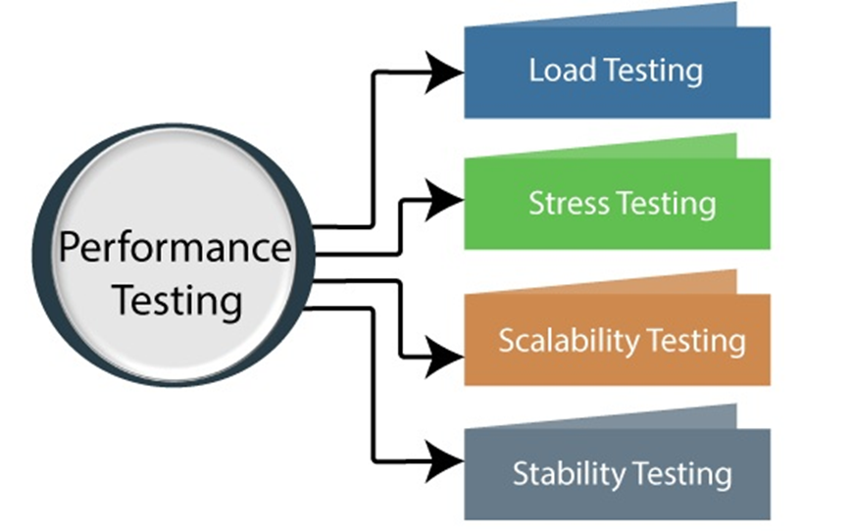

Slide 76
2.11.2 Usability Testing
Usability Testing also known as User Experience(UX) Testing, is a testing method for measuring how easy and user-friendly a software application is. A small set of target end-users, use software application to expose usability defects. Usability testing mainly focuses on user’s ease of using application, flexibility of application to handle controls and ability of application to meet its objectives

Slide 77
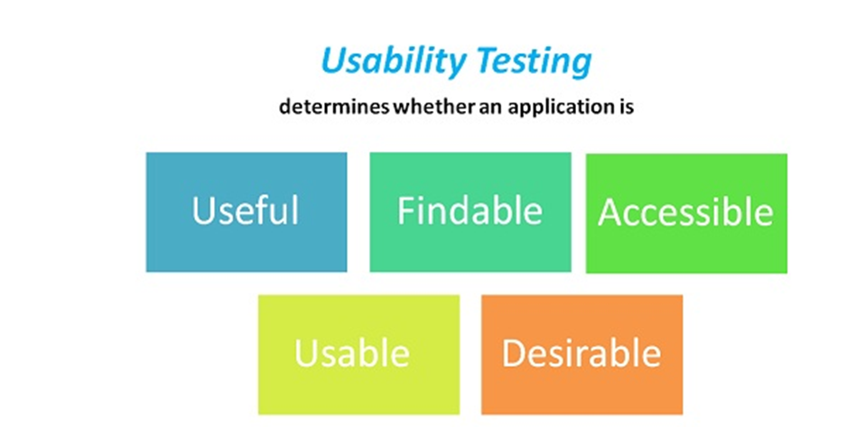
“Checking the user-friendliness, efficiency, and accuracy of the application is known as Usability Testing. “

Slide 78
In Usability Testing, the user-friendliness can be described with the help of the following characteristics
Easy to understand
Easy to access
Look and feel
Faster to Access
Effective Navigation
Good Error Handling

Slide 79
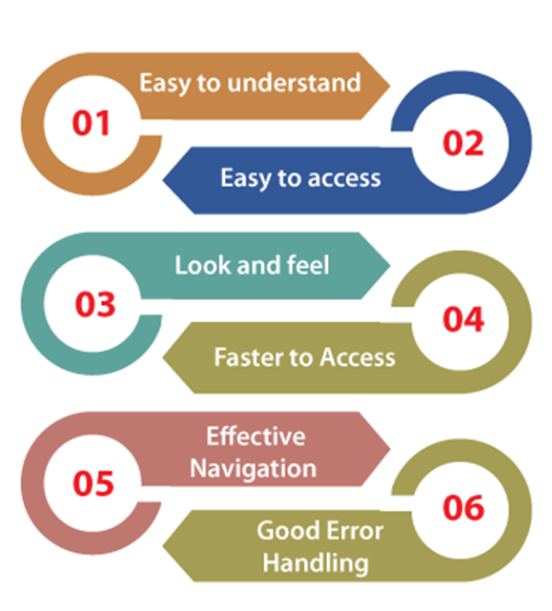

Slide 80
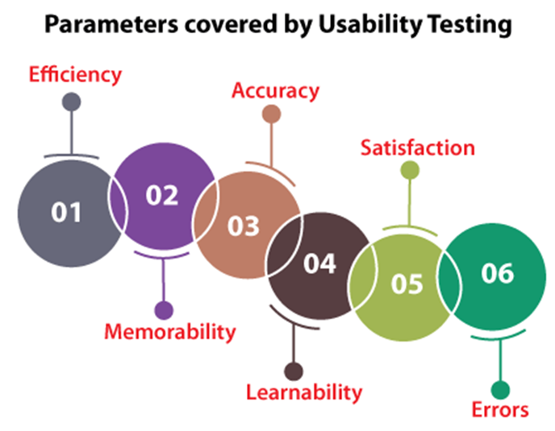

Slide 81
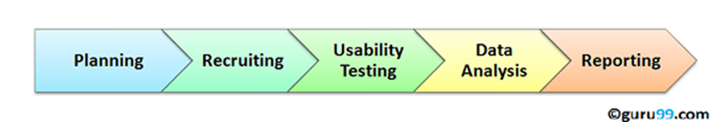
Usability testing process consists of the following phases

Slide 82
2.11.3 Maintainability Testing
The term maintainability corresponds to the ability to update or modify the system under test. This is a very important parameter as the system is subjected to changes throughout the software life cycle.
To make Maintainability Testing more effective, testers should include static analysis and reviews as these are hard to spot during dynamic testing while it is easily captured in code walkthrough and inspection

Slide 83
Software maintainability consists of four types
1.CORRECTIVE
Corrective maintenance is defined as maintenance of bugs or errors. It means when the error is detected in the software then the corrective maintenance is required to fix it. These bugs or errors are responsible for the faults which may appear in the code, design or logic of the software. Sometimes the user asks for the enhancements of the software and not about fixing the bugs. Corrective maintenance requires the correction of existing faults in the software. Sometimes a change in hardware also cause bugs or errors.

Slide 84
2.ADAPTIVE
Adaptive maintenance includes the environmental changes where your software is living. Changes to the hardware, operating system, software dependencies, and organizational business rules and policies are handled in adaptive maintenance. By these modifications to the environment, changes can occur in the other parts of the software. In changing circumstances adaptive maintenance is required to keep your software fresh or to increase the lifetime of the software

Slide 85
3.PERFECTIVE
Perfective maintenance refers to the changes in features and requirements in your existing system. After sometime when user suggests for new features and new functionality of the software than adaptive maintenance is used. In adaptive maintenance, some features are removed from the software which features are not effective for the software. Adaptive maintenance involves 50-55% of the maintenance work.

Slide 86
4.PREVENTIVE
Perfective maintenance maximizes the maintainability or understanding of the software system. Documentation updating or code optimizing are involved in preventive maintenance. Preventive maintenance helps the software to become more scalable, stable, understandable, maintainable. This maintenance acts as medicine to prevent the problems. Restructuring the data and code of the software are implemented in preventive maintenance

Slide 87
2.11.4 Portability
It is a measure of how easily an application can be transferred from one computer environment to another. A computer software application is considered portable to a new environment if the effort required to adapt it to the new environment is within reasonable limits. The meaning of the abstract term 'reasonable' depends upon the nature of the application and is often difficult to express in quantifiable units

Slide 88
The phrase "to port" means to modify software and make it adaptable to work on a different computer system. For example, to port an application to Linux means to modify the program so that it can be run in a Linux environment.

Slide 89
2.11.5 Security
Security Testing is a type of Software Testing that uncovers vulnerabilities, threats, risks in a software application and prevents malicious attacks from intruders. The purpose of Security Tests is to identify all possible loopholes and weaknesses of the software system which might result in a loss of information, revenue, repute at the hands of the employees or outsiders of the Organization.

Slide 90
Security testing is an integral part of software testing, which is used to discover the weaknesses, risks, or threats in the software application and also help us to stop the nasty attack from the outsiders and make sure the security of our software applications.

Slide 91
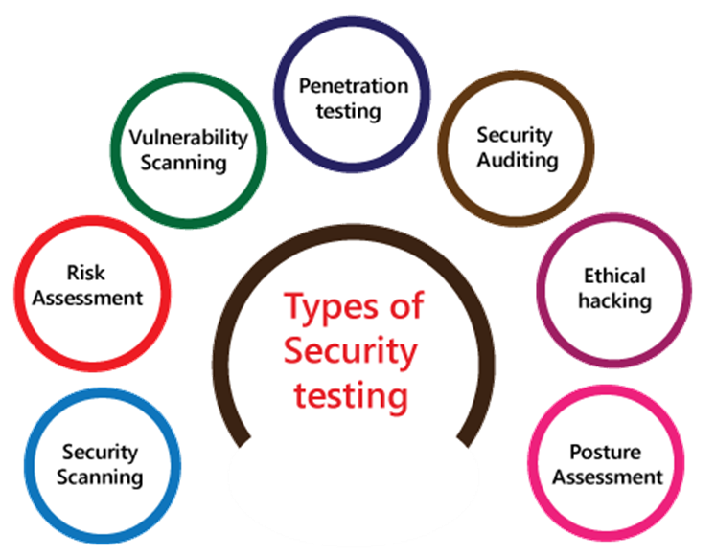

Slide 92
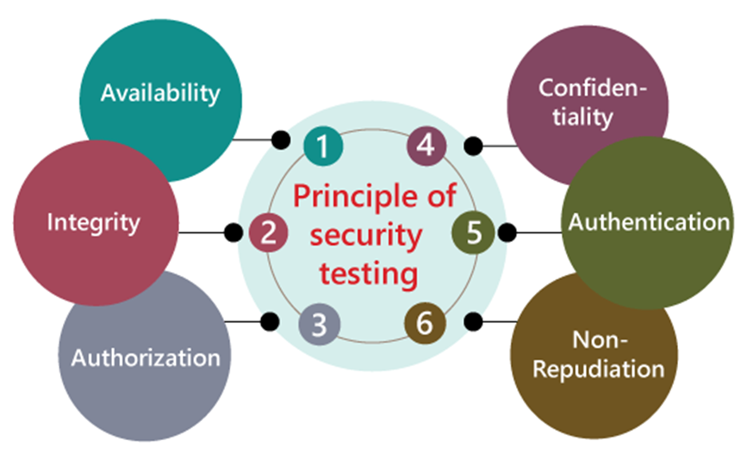

Slide 93
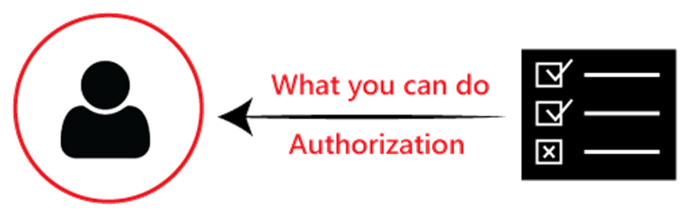

Authorization & Authentication

Slide 94
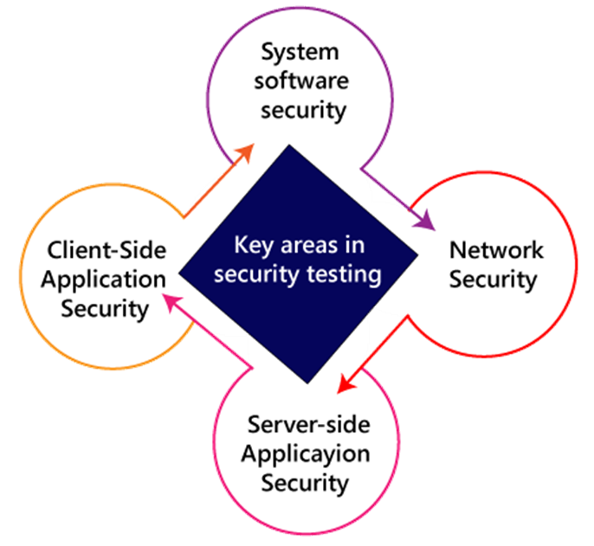

Slide 95
2.11.6 Localization & Internationalization
Localization Testing:-
Localization testing is the software testing process for checking the localized version of a product for that particular culture or locale settings. The areas affected by localization testing are UI and content.
It is nothing but a format of software testing. We test the particular application based on the country, region, etc. As we know, the Localized product only supports the precise kind of languages that are usable only in a specific region

Slide 96
Globalization Testing
Globalization Testing is a software testing method used to ensure that the software application can function in any culture or locale (language, territory or code page) by testing the software functionalities using each type of international input possible. The purpose of Globalization testing is to ensure that software can be used internationally or worldwide. It is also called Internationalization Testing

Slide 97
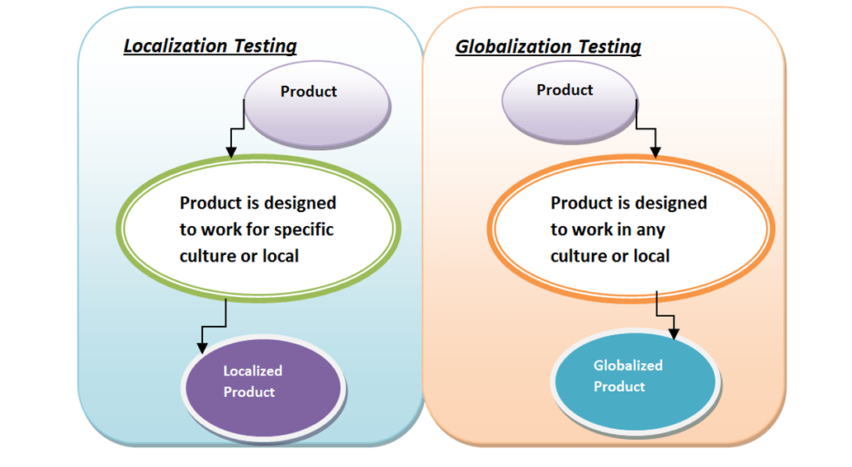

Slide 98
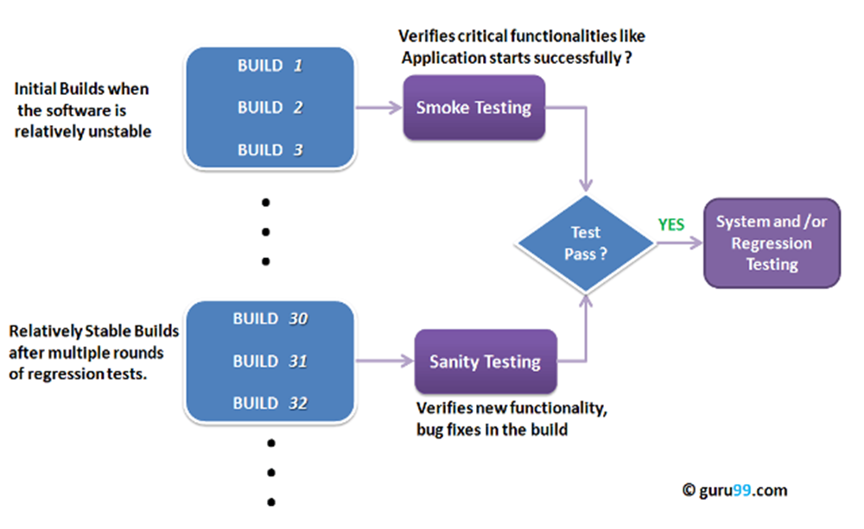
2.12 :- Concept of Smoke testing and Sanity Testing

Slide 99
Smoke Testing is a software testing technique performed post software build to verify that the critical functionalities of software are working fine. It is executed before any detailed functional or regression tests are executed. The main purpose of smoke testing is to reject a software application with defects so that QA team does not waste time testing broken software application

Slide 100
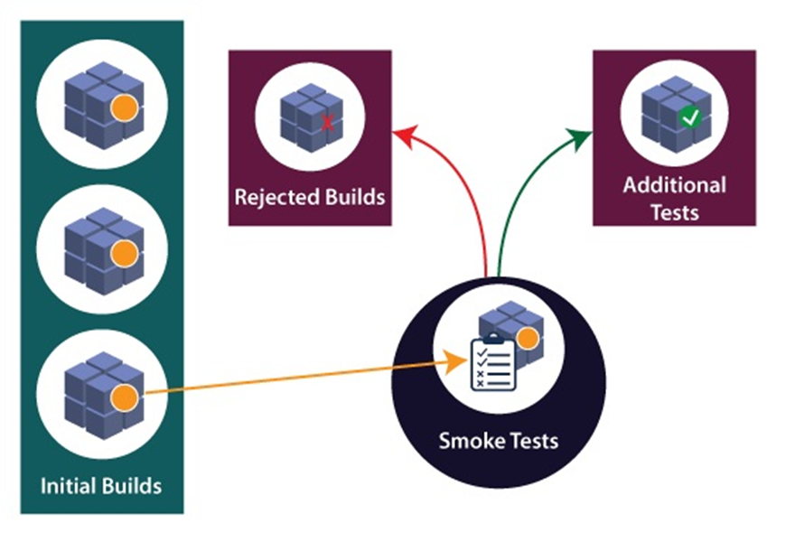

Slide 101
Sanity Testing
Sanity testing is a kind of Software Testing performed after receiving a software build, with minor changes in code, or functionality, to ascertain that the bugs have been fixed and no further issues are introduced due to these changes. The goal is to determine that the proposed functionality works roughly as expected. If sanity test fails, the build is rejected to save the time and costs involved in a more rigorous testing.

Slide 102
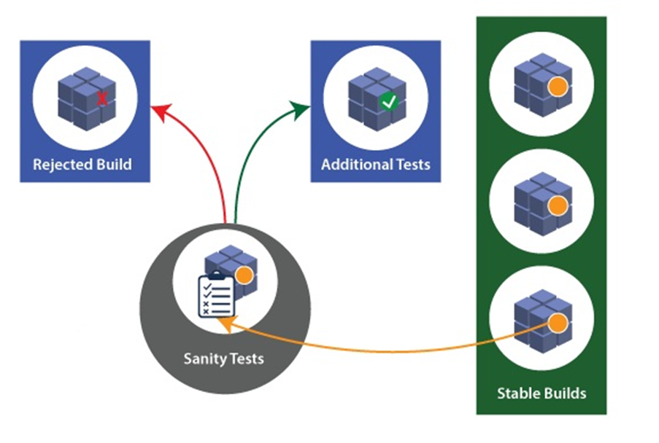

Slide 103
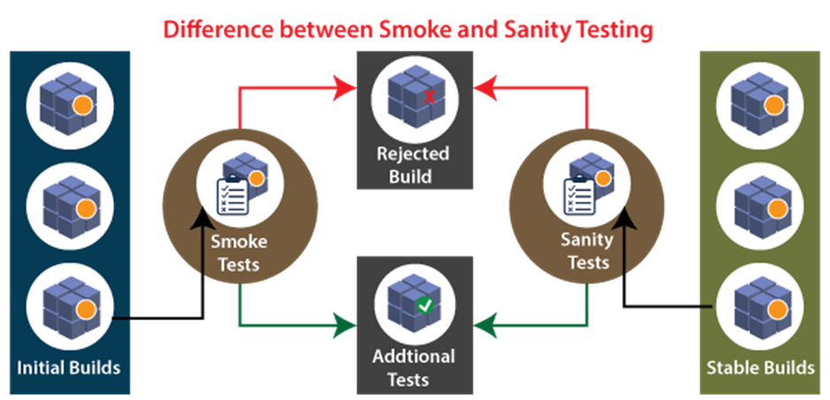
The key difference between Smoke Testing and Sanity Testing

Slide 104
S.No. | Comparison Basis | Smoke Testing | Sanity Testing
1 | Test coverage | It is a broad approach to testing where all parts of the application are tested. | It is a narrow approach to testing where specific parts of the application are tested.
2 | Measures | It measures the stability of the system by performing rigorous testing. | It measures the rationality of the system by performing rigorous testing.
3 | Technique | Smoke testing can be either manual or automated. | Sanity testing can be done without test cases or scripts.
4 | Executed by | It is performed by both testers and developers. | It is performed by only testers.
5 | Purpose | Testing is done without getting into deep but whenever needed tester has to go into deep. | Sanity testing does not need to go into deep of the application.
6. | Performed at | Smoke testing is the first testing performed on the initial build. | Sanity testing is performed when the build is comparatively stable.
7 | Documentation | Smoke testing is documented. | Sanity testing is not documented.
8 | Used to | It is used to test End to End function of the application. | It is used to test only modified or defect fixed functions.
9 | Subset | It is considered as a subset of acceptance testing. | It is considered as a subset of regression testing.

